Slide 1

Algorithms
Algorithms Solve Problems
Algorithm Efficiency
Algorithm exercises

Slide 2

Algorithms Solve Problems

Slide 3

Prompt:
Intro video
https://youtu.be/e_WfC8HwVB8

Slide 4


Slide 5

Unit 6 Lesson 1 - Activity
Go around the room and write down your answers to these problems.
Problems
Find a person whose birthday is before yours
Find a person whose birthday is after yours
Find the person whose birthday is the closest before yours
Find the person whose birthday is the closest after yours
Notes:
Problems 1 and 2 are very similar. As soon as you find one person who meets the criteria you know you're doneProblem 3 and 4 are very similar but you need to talk to every other student to answer it. You only need to keep track of the closest birthday you've heard so far, however.
dato

Slide 6
Unit 6 Lesson 1 - Activity
Prompt:
Share your pair -how you went about solving each of these problems.
How to draw a flow diagram?

Slide 7
Unit 6 Lesson 1 - Activity
Algorithm 1
MOVE_FORWARD()
TURN_RIGHT()
MOVE_FORWARD()
TURN_RIGHT()
MOVE_FORWARD()
TURN_RIGHT()
MOVE_FORWARD()
TURN_RIGHT()
Algorithm 2
REPEAT 2 TIMES
{
MOVE_FORWARD()
MOVE_FORWARD()
TURN_RIGHT()
MOVE_FORWARD()
TURN_RIGHT()
}
With your partner decide which of these programs are “the same” as one another.
Algorithm 4
Start
Start
Algorithm 6
count ← 0
count ← 0
count < 4
false
true
count < 2
false
true
End
MOVE_FORWARD()
TURN_RIGHT()
count ← count + 1
End
MOVE_FORWARD()
MOVE_FORWARD()
turnCount ← 0
Algorithm 5
REPEAT 2 TIMES
{
REPEAT 2 TIMES
{
MOVE_FORWARD()
}
REPEAT 3 TIMES
{
TURN_LEFT()
}
MOVE_FORWARD()
REPEAT 3 TIMES
{
TURN_LEFT()
}
}
Algorithm 3
moves ← [“F”, “R”, “F”, “R”, “F”, “R”, “F”, “R”]
FOR EACH move IN moves
{
IF (move = “F”)
{
MOVE_FORWARD()
}
ELSE
{
TURN_RIGHT()
}
}
turnCount < 3
false
true
MOVE_FORWARD()
TURN_RIGHT()
count ← count + 1
TURN_LEFT()
turnCount ← turnCount + 1

Slide 8
Unit 6 Lesson 1 - Activity
Prompt:
Discuss with in a group
which of these algorithms are “the same” as one another?

Slide 9


Slide 10


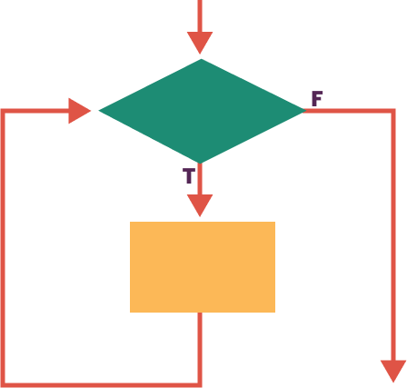
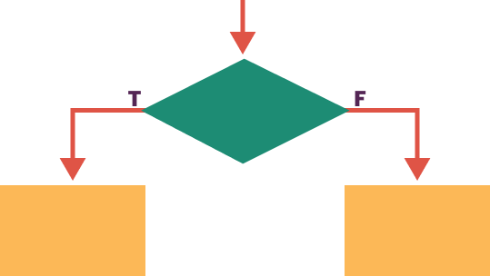
Unit 6 Lesson 1 - Wrap Up
Problem: a general description of a task that can (or cannot) be solved with an algorithm
Algorithm: a finite set of instructions that accomplish a task.
There are usually many algorithms to solve the same problem, and many ways to write or express one algorithm including natural language, psuedocode, diagrams, and are implemented using programming code. All algorithms can be created by combining steps in three different ways.
Sequencing Putting steps in an order
Selection Deciding which steps to do next
Iteration Doing some steps over and over

Slide 11
Unit 6 - Lesson 2
Algorithm Efficiency

Slide 12
Unit 6 Lesson 2 - Wrap Up
Efficiency: a measure of how many steps are needed to complete an algorithm
Linear Search: a search algorithm which checks each element of a list, in order, until the desired value is found or all elements in the list have been checked.
Binary Search: a search algorithm that starts at the middle of a sorted set of numbers and removes half of the data; this process repeats until the desired value is found or all elements have been eliminated.
15
14
13
12
11
10 9 8 7 6 5 4 3 2 1
LINEAR
Binary Search
1 2 3 4 5 6 7 8 9 10 11 12 13 14 15

Slide 13


Slide 14
What can I use Algorithms Real-World Applications?

Slide 15
1 Navigation Systems: GPS algorithms help find the shortest routes. Optimize travel time and distance.

Slide 16
2 Recommendation Systems: Algorithms suggest products, movies, based on user preferences. Enhance user experience and increase engagement.

Slide 17
3 Machine Learning: Algorithms form the core of various ML models. Enable pattern recognition, predictions, and decision-making. 4 Cryptography: Encryption and decryption algorithms ensure secure communication. Safeguard sensitive information. 5 Optimization Problems: Algorithms solve resource allocation, scheduling, and logistics challenges. Maximize efficiency in various industries.

Slide 18
Øvelse1 http://www.docjava.dk/grundlaeggende_programmering/algoritmer/opgaver.htm

Slide 19
Find a Real-World Algorithm Applications within the 5 category e.g. Algorithm Design: Definition: Creating step-by-step instructions to solve a problem. Importance: Provides a clear and repeatable process for arriving at a solution

Slide 20
Extra øvelse

Slide 21
What is computational thinking?

Slide 22
Characteristic | Description
Abstraction | Reducing complexity to basic ideas
Algorithm | Identifying process and sequence
Decomposition | Breaking artefacts, processes or systems into component parts
Generalisation | Identifying commonalities between component parts.
Analysis | Analysing functionality of systems.
Evaluation | Systematically evaluation of the value of systems.

Slide 23
Reference https://drive.google.com/file/d/1XgL9-oGl3cNIFk2zcQWhX622KMvyk6LM/view?pli=1 https://www.systime.dk/systimenyt/post/gratis-webinar-computational-thinking-hvorfor-hvordan-og-hvad-med-chatgpt

